Slide 1
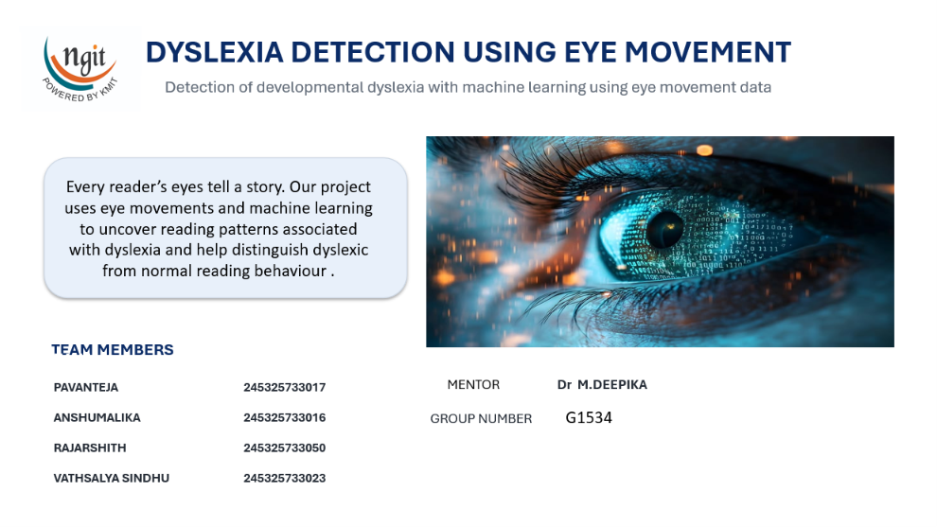
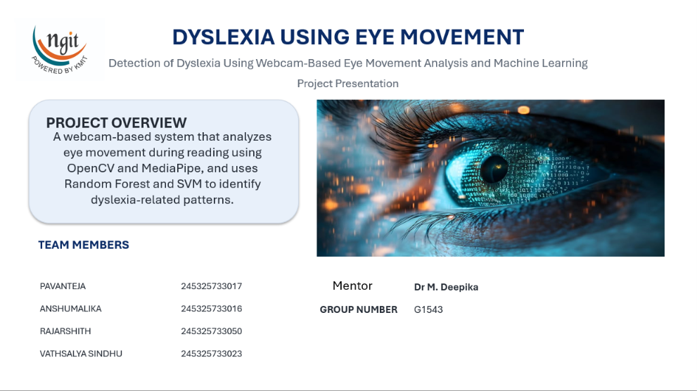
DYSLEXIA
DETECTION
Machine learning approach for identifying reading-pattern differences from eye-movement data
294
participants
12
features
Binary target:
Normal / Dyslexia
GROUP G-1534

Slide 2
Understanding the Base Paper
02
L
Key Idea
Limitation of the Base Paper
• Reading produces measurable eye movements such as fixations, saccades and regressions.
• These measurements can be represented as numerical features.
• Machine learning can learn patterns that separate labelled reading groups.
• The base paper mainly focuses on binary classification, identifying readers as dyslexic or non-dyslexic.
• It does not provide a continuous risk/level measure, so the outcome is limited to a yes/no prediction.
Our project uses a webcam-based system to capture eye-movement patterns during reading.
It provides both a dyslexia risk label and an estimated risk level.
This gives a more detailed and informative outcome than binary classification alone.
Enhancements
•
Our project uses a webcam-based system to capture eye-movement patterns during reading.
• It provides both a dyslexia risk label and an estimated risk level.
• This gives a more detailed and informative outcome than binary classification alone.
Dyslexia Detection Using Eye Movements • G-1534
Milestone 1

Slide 3
PROBLEM DEFINITION
03
What problem are we addressing?
Core problem
• Eye-tracking studies generate many measurements for each participant.
• Manually interpreting multiple fixation, saccade and regression measures is difficult.
• A machine-learning workflow can organize these measurements and identify patterns in labelled data.
READING
BEHAVIOUR
Fixation
Where the eyes pause
Saccade
Movement to another point
Why this matters
Regression
Movement back in the text
• Provides a quantitative way to study reading behaviour.
• Supports consistent analysis across many participants.
• Can act as a screening-oriented research prototype—not a clinical diagnosis.
Reading time
Time spent reading
Dyslexia Detection Using Eye Movements • G-1534
Milestone 1

Slide 4
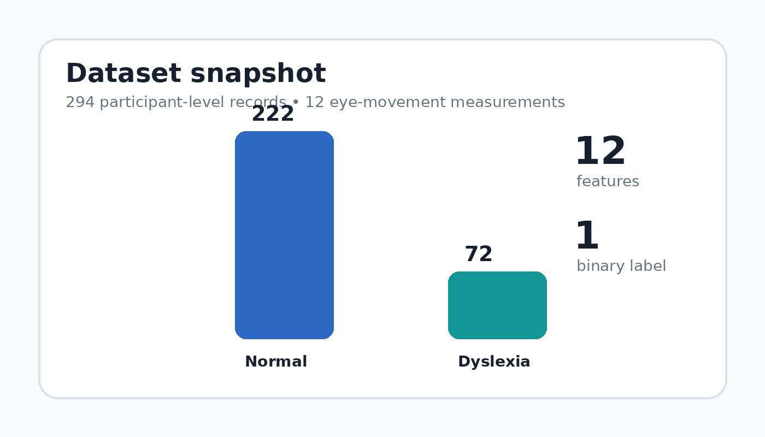
DATASET AT A GLANCE
04
What is actually in our project dataset?
Dataset facts
• 294 participant-level records.
• 12 numerical eye-movement measurements.
• Target column: Dyslexic_label.
• Class labels: norm and dyslexia.
• Class distribution: 222 normal and 72 dyslexia.
FEATURE GROUPS
Fixation
Reading time
Regression measures
Saccade
Regression path duration
Skip
Dyslexia Detection Using Eye Movements • G-1534
Milestone 1

Slide 5
PROJECT SCOPE
05
What we will and will not build
IN SCOPE
OUT OF SCOPE
• Use the provided participant-level eye-movement dataset.
• Clean and validate numerical features.
• Explore relationships between eye-movement measurements and the binary label.
• Train and evaluate machine-learning classification models.
• Develop a simple prediction workflow for project demonstration.
• Replacing a psychologist, clinician or formal dyslexia assessment.
• Providing medical treatment or therapy.
• Claiming that eye movements alone prove dyslexia.
• Using the prototype as a clinical diagnostic device.
Dyslexia Detection Using Eye Movements • G-1534
Milestone 1

Slide 6
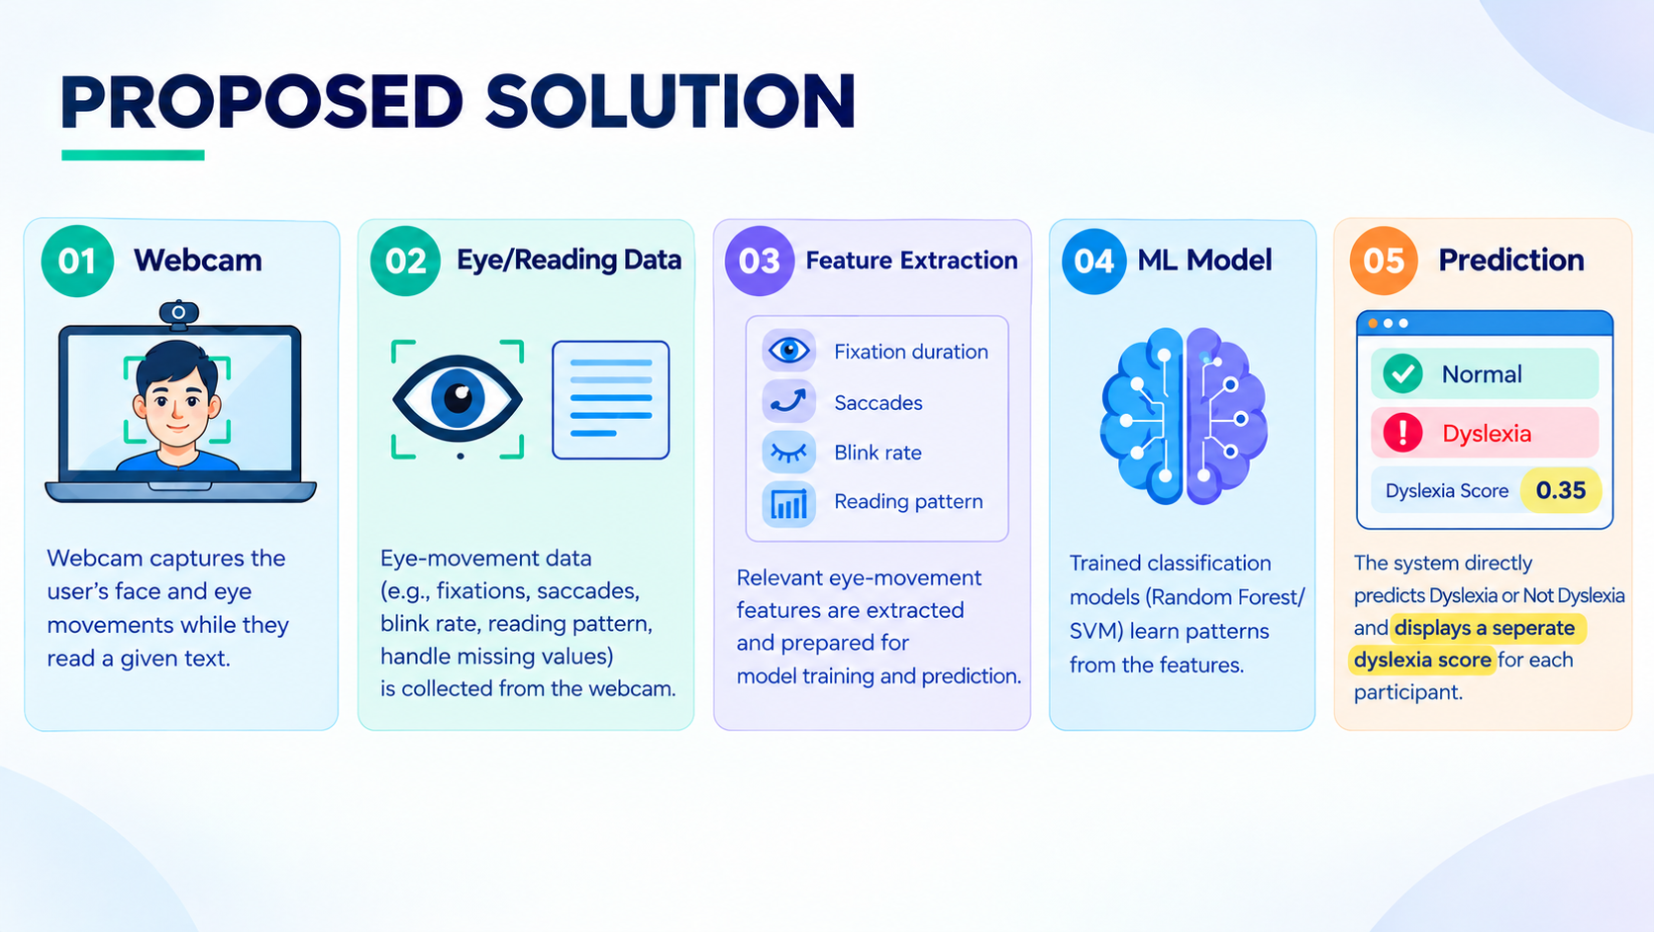
OUR PROPOSED SOLUTION
06
06
01
02
03
04
DATA PREPARATION
FEATURE ANALYSIS
ML CLASSIFICATION
PREDICTION
Clean and validate participant-level eye-movement data and handle missing values.
Use the 12 numerical eye-movement measurements to capture reading behavior.
Train classification models to learn patterns separating Normal and Dyslexia groups.
Generate a screening-oriented Normal / Dyslexia prediction for each participant.
Raw eye-movement measurements → validated features → ML classification → screening-oriented prediction

Slide 7
KEY FEATURES
07
FIXATIONS
READING TIME
GAZE POSITION
FIXATION_COUNT
FIXATION_DURATION
TOTAL_READING_TIME
RUN_TOTAL_READING_TIME
FIXATION_X
FIXATION_Y
SACCADE
REGRESSIONS
PATH / SKIP
SACCADE_AMPLITUDE
REGRESSION_IN
REGRESSION_OUT
REGRESSION_OUT_FULL
REGRESSION_PATH_DURATION
SKIP
Dyslexia Detection Using Eye Movements • G-1534
Milestone 1

Slide 8
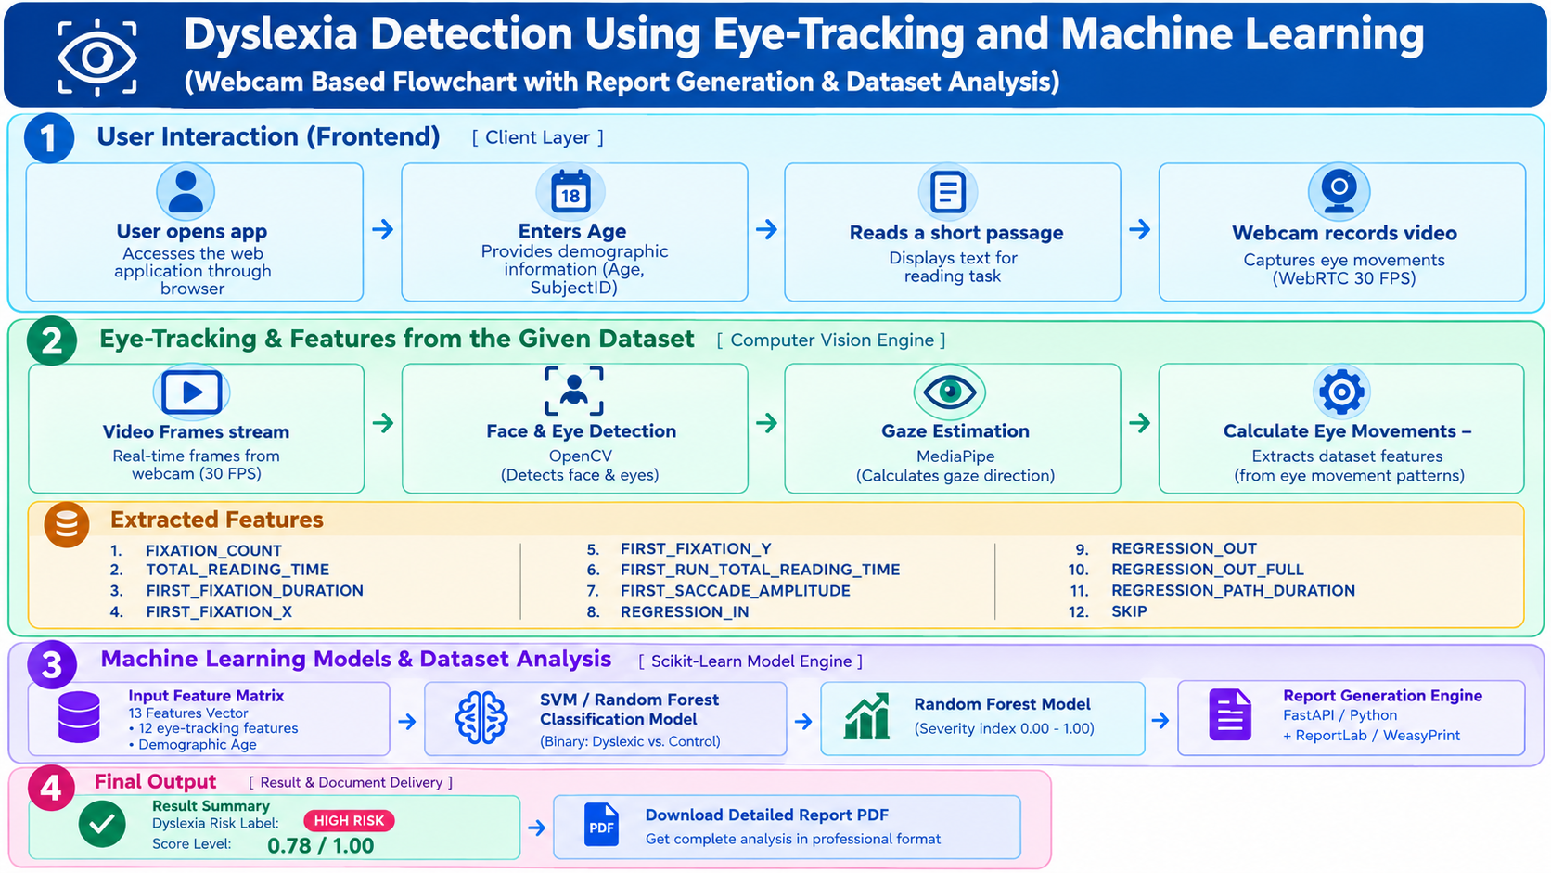
SYSTEM ARCHITECTURE
08
Dyslexia Detection Using Eye Movements • G-1534
Milestone 1

Slide 9
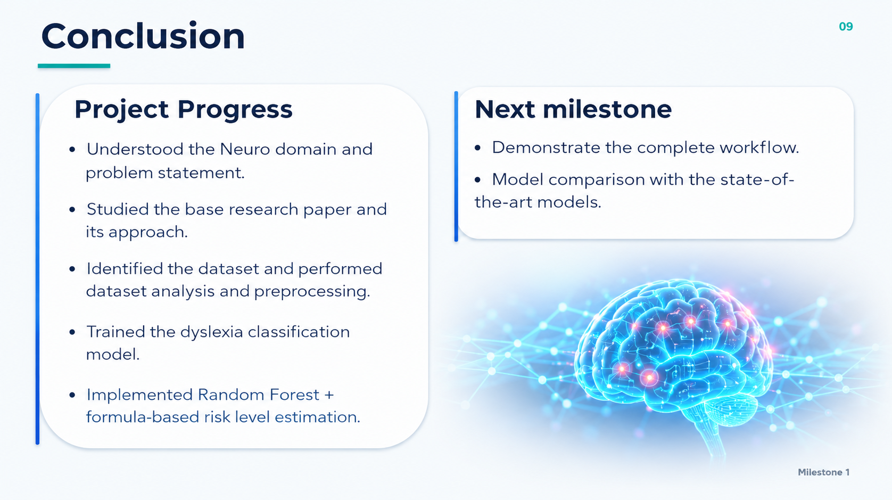
Conclusion
09
Project Progress
• Understood the Neuro domain and problem statement.
• Studied the base research paper and its approach.
• Identified the dataset and performed dataset analysis and preprocessing.
• Trained the dyslexia classification model.
• Implemented Random Forest + formula-based risk level estimation.
Next milestone
• Demonstrate the complete workflow.
• Model comparison with the state-of-the-art models.
Milestone 1

Slide 10


